Slide 1
A Tutorial on SOMPy Toolbox

Slide 2
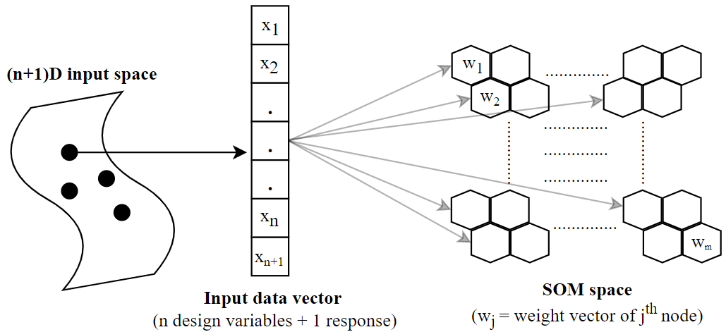





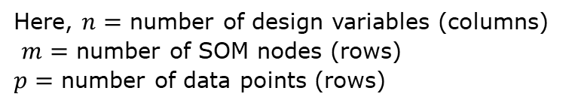
Self-Organizing Maps
An Artificial Neural Network (ANN) algorithm
Used for visualizing n-D data into low dimensional space (usually 2D)
Preserves structure of the input data
Input matrix
$$x_{1}=[x_{11},x_{12},x_{13},…,x_{1n},x_{1(n+1)}]$$
$$x_{2}=[x_{21},x_{22},x_{23},…,x_{2n},x_{2(n+1)}]$$
:
$$x_{p}=[x_{p1},x_{p2},x_{p3},…,x_{pn},x_{p(n+1)}]$$
Codebook/weight matrix
$$w_{1}=[w_{11},w_{12},w_{13},…,w_{1n},w_{1(n+1)}]$$
$$w_{2}=[w_{21},w_{22},w_{23},…,w_{2n},w_{2(n+1)}]$$
:
$$w_{m}=[w_{m1},w_{m2},w_{m3},…,w_{mn},w_{m(n+1)}]$$
Here, $n=$ number of design variables (columns)
$m=$ number of SOM nodes (rows)
$p=$ number of data points (rows)

Slide 3
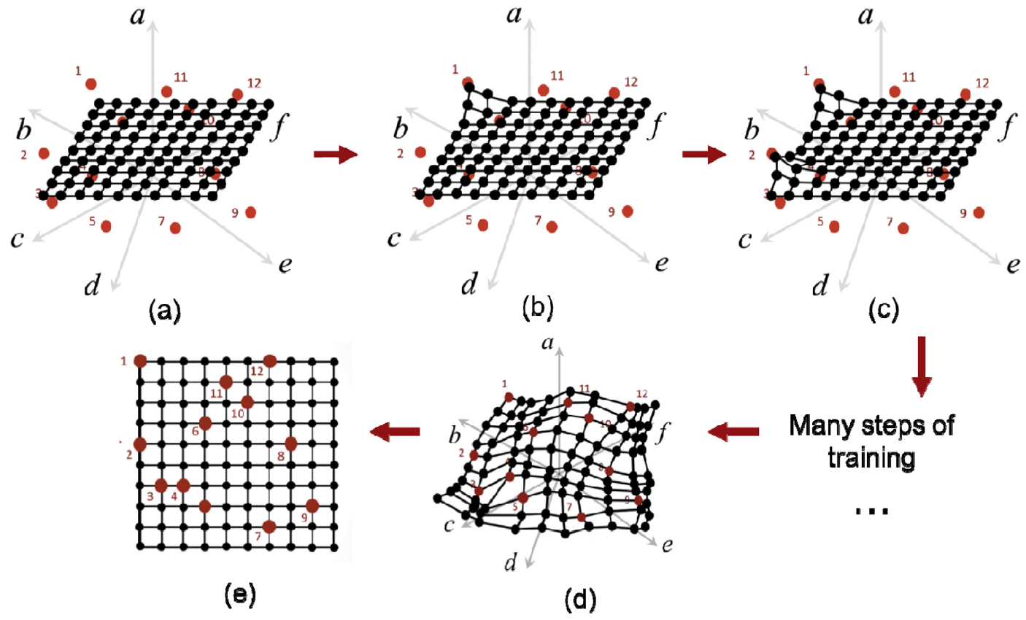


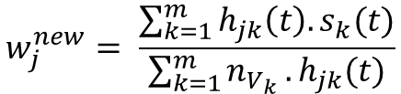

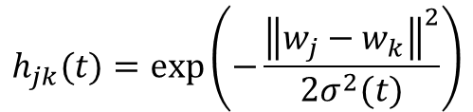
Self-Organizing Maps
SOM Training process
Best Matching Unit (BMU) of data $x_{i}$
$$c_{i}=\min_{id}{(\left\|x_{i}−w_{j}\right\|)}$$
Weight update of node $j$ by batch training
$$s_{j}\left(t\right)=\sum_{i=1}^{n_{V_{j}}}{x_{i}}$$
$$w_{j}^{new}= \frac{\sum_{k=1}^{m}{h_{jk}\left(t\right).s_{k}(t)}}{\sum_{k=1}^{m}{n_{V_{k}}}.h_{jk}(t)}$$
Neighborhood function $h_{jk}\left(t\right)$
$$h_{jk}(t)=exp\left(−\frac{{\left\|w_{j}−w_{k}\right\|}^{2}}{2σ^{2}(t)}\right)$$

Slide 4
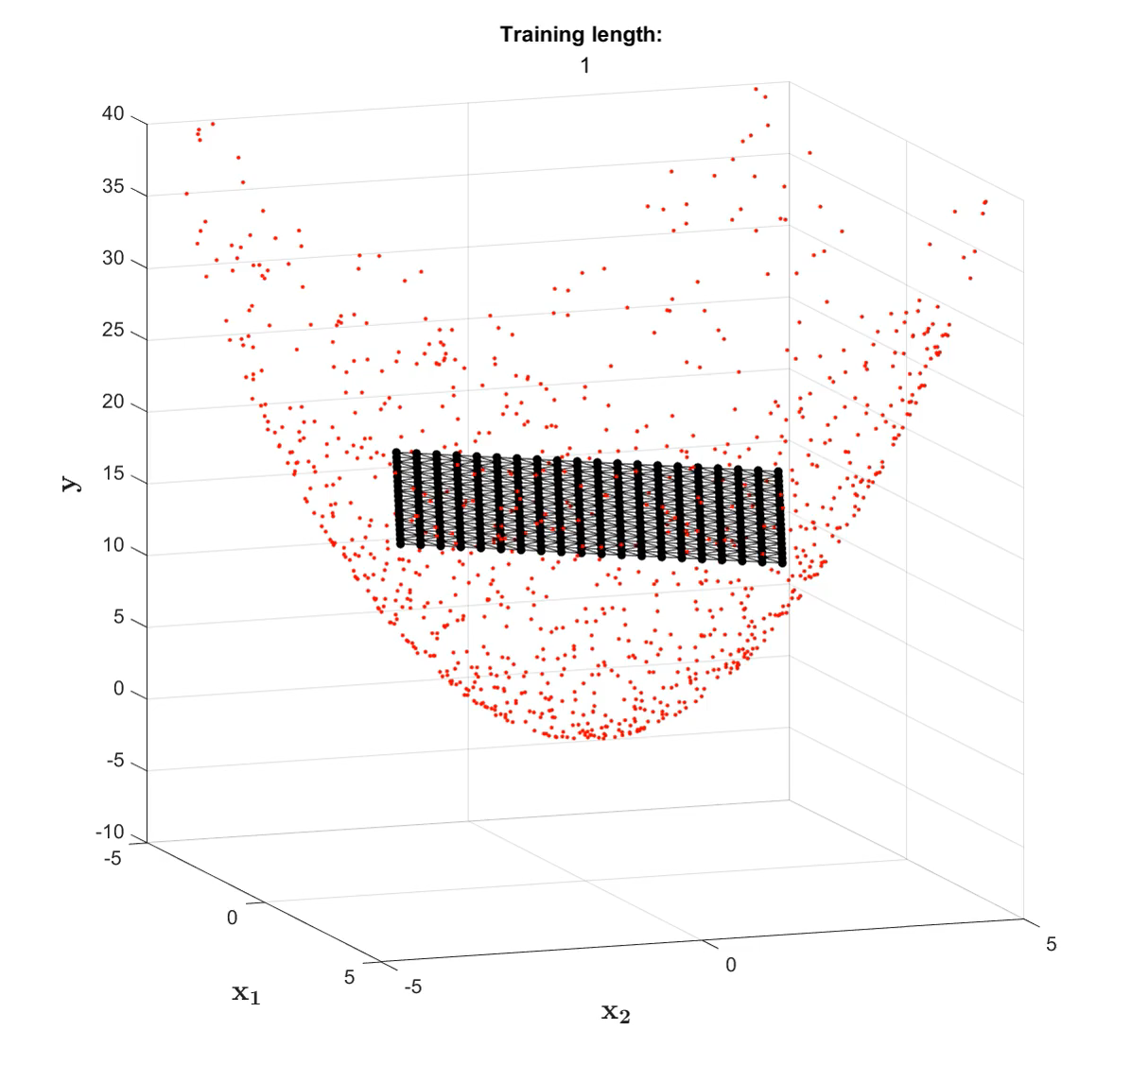
Self-Organizing Maps
SOM Training process
Best Matching Unit (BMU) of data $x_{i}$
$$c_{i}=\min_{id}{(\left\|x_{i}−w_{j}\right\|)}$$
Weight update of node $j$ by batch training
$$s_{j}\left(t\right)=\sum_{i=1}^{n_{V_{j}}}{x_{i}}$$
$$w_{j}^{new}= \frac{\sum_{k=1}^{m}{h_{jk}\left(t\right).s_{k}(t)}}{\sum_{k=1}^{m}{n_{V_{k}}}.h_{jk}(t)}$$
Neighborhood function $h_{jk}\left(t\right)$
$$h_{jk}(t)=exp\left(−\frac{{\left\|w_{j}−w_{k}\right\|}^{2}}{2σ^{2}(t)}\right)$$

Slide 5
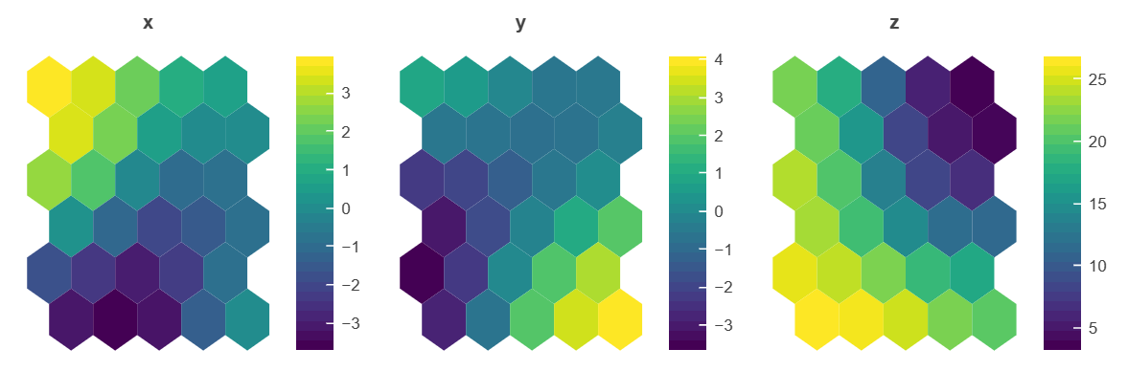
























Self-Organizing Maps
SOM Plots – 1. Component planes
Updated Codebook/weight matrix
$$w_{1}=[w_{11},w_{12},w_{13}]$$
$$w_{2}=[w_{21},w_{22},w_{23}]$$
:
$$w_{30}=[w_{30,1},w_{30,2},w_{30,3}]$$
$$w_{11}$$
$$w_{71}$$
$$w_{12}$$
$$w_{72}$$
$$w_{13}$$
$$w_{73}$$
$$w_{21}$$
$$w_{81}$$
$$w_{22}$$
$$w_{82}$$
$$w_{23}$$
$$w_{83}$$
$$w_{31}$$
$$w_{91}$$
$$w_{32}$$
$$w_{92}$$
$$w_{33}$$
$$w_{93}$$
$$w_{30,1}$$
$$w_{30,2}$$
$$w_{30,3}$$

Slide 6
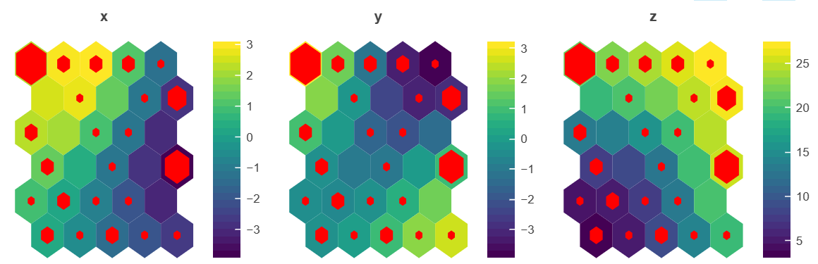
Self-Organizing Maps
SOM Plots – 2. Hitmap
To visualize number of data points mapped to the nodes
Higher the size, larger the count of data points

Slide 7
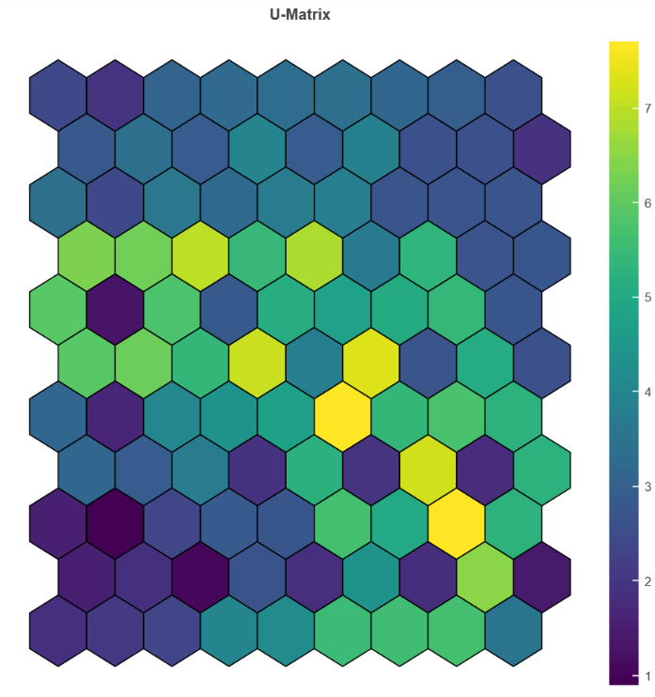
Self-Organizing Maps
SOM Plots – 3. Umatrix plot
To visualize distance between the nodes
1
7
Represents node (can be average, median, mode)
2
8
Distance between node 2 and node 3
3
9
4
Distance between node 3 and node 9
5
6
30

Slide 8
SOMPy Library
Toolbox structure
sompy
normalization.py
Libraries needed:
1. numpy
2. scipy
3. sklearn
4. pandas
5. Bokeh
6. matplotlib
visualization
neighborhood.py
viz_functions.py
codebook.py
comp_planes.py
sompy_csom.py
hitmaps.py
sompy_isom.py
umatrix.py
aux_fun.py
__init__.py
decorators.py
Not updated based on modified changes (Skip for now)
setup.py
__init__.py

Slide 9
SOMPy Library
SOM Grid structure
Regular hexagon
60 deg
5
11
29
1 unit distance
4
10
3
9
(0,1.73)
2
8
codebook.py
(0.5,0.866)
1
7
Attribute updated: sm._distance_matrix
(0,0)
0
6
12

Slide 10
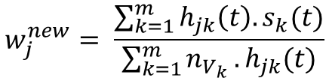
SOMPy Library
Initialization
sompy_csom.py
or
sompy_isom.py
som_randinit()
random_initialization()
codebook.py
som_lininit()
pca_linear_initialization()
Training
Update sm._bmu
sompy_csom.py
or
sompy_isom.py
Update sm.codebook.matrix
train()
rough_train()
finetune_train()
$$w_{j}^{new}= \frac{\sum_{k=1}^{m}{h_{jk}\left(t\right).s_{k}(t)}}{\sum_{k=1}^{m}{n_{V_{k}}}.h_{jk}(t)}$$
batchtrain()

Slide 11
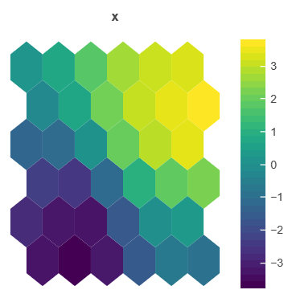
SOMPy Library
Visualization of component planes
Creates bokeh figure objects via som_cplanes()
Plots component planes of set height(h) and width(w) via gridplot()
viz.plot_cplanes(sm)
1
2
3
4
5
6
30

Slide 12
SOMPy Library
Visualization of component planes
Creates bokeh figure objects via som_cplanes()
Plots component planes of set height(h) and width(w) via gridplot()
viz.plot_cplanes(sm)
1
Hexagonal tiles are placed at the coordinates based on axial system and not cartesian system
2
3
4
5
6
30

Slide 13
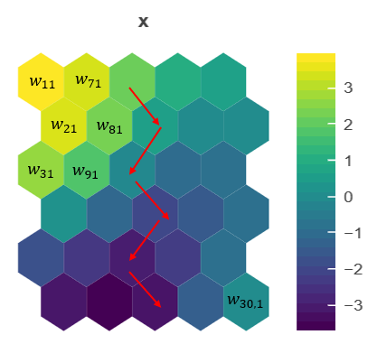
SOMPy Library
Visualization of component planes
Creates bokeh figure objects via som_cplanes()
Plots component planes of set height(h) and width(w) via gridplot()
viz.plot_cplanes(sm)
1
Color coded as per node weights
Color mapping done via matplotlib library
2
3
4
5
6
30

Slide 14
SOMPy Library
Visualization of component planes
Creates bokeh figure objects via som_cplanes()
Plots component planes of set height(h) and width(w) via gridplot()
viz.plot_cplanes(sm)
fig_obj[0]
fig_obj[1]
fig_obj[2]
grid_plots (Line 165 in viz_functions.py)
(Line 82 in comp_planes.py)

Slide 15
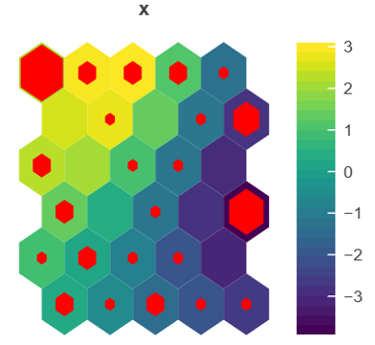
SOMPy Library
Visualization of hitmaps
Creates bokeh figure objects via som_hitmap()
Plots component planes of set height(h) and width(w) via gridplot()
viz.plot_hitmap(sm)
1
Hexagon tiles placed twice. One for component plane and other for hits
2
3
4
5
6
30

Slide 16
SOMPy Library
Visualization of Umatrix
Creates bokeh figure via som_umatrix_map()
Plots component plane of set height(h) and width(w)
viz. plot_umat(sm)

